Slide 1
Outline Of Today’s Discussion
Some Disparities are Not Retinal: Pulfrich Effect
Random-Dot Stereograms
Binocular Rivalry
Motion Parallax

Slide 2
Part 1
Some Disparities Are Not Retinal
(Pulfrich Effect)

Slide 3
Pulfrich Effect
Let’s repeat the Pulfrich Demo.
You’ll see dots that move across the screen. Half the dots move left, and half the dots move right.
To the naked eye, all the dots are in the same depth plane.
Then, apply the filter to one eye, while the other eye views the stimuli without a filter.
START THE PULFRICH DEMO NOW

Slide 4
Pulfrich Effect
Let’s review the Pulfrich Effect.
Physically, all the stimuli were in the same depth plane at all times.
Perceptually, more than one depth plane was seen when the light reaching one eye was attenuated.
This depth difference occurred despite the fact that there were no positional disparities on the retinas.
Let’s consider how the filter affects Cortical Cells…

Slide 5
Greater Intensity = Faster Cortical Response
These “data” are for
illustration only.

Slide 6
Filter before RIGHT eye: Motion is Leftward
Dot position at each instant in time
6 5 4 3 2 1
Left eye’s input
is received quickly
Right eye’s input
is delayed by filter
Cortical
Cell
Input from the right eye is “displaced” rightward
(i.e., back in time), creating an uncrossed disparity (far).

Slide 7
Strong Filter before RIGHT eye: Motion is Leftward
Dot position at each instant in time
6 5 4 3 2 1
Left eye’s input
is received quickly
Right eye’s input is further
delayed by the stronger filter
Cortical
Cell
Input from the right eye is “displaced” further rightward
(i.e., back in time), creating a larger uncrossed disparity (farther).

Slide 8
Filter before RIGHT eye: Motion is Rightward
Dot position at each instant in time
1 2 3 4 5 6
Right eye’s input
is delayed by filter
Left eye’s input
is received quickly
Cortical
Cell
Input from the right eye is “displaced” leftward
(i.e., back in time), creating a crossed disparity (near).

Slide 9
Strong Filter before RIGHT eye: Motion is Rightward
Dot position at each instant in time
1 2 3 4 5 6
Right eye’s input is further
delayed by the stronger filter
Left eye’s input
is received quickly
Cortical
Cell
Input from the right eye is “displaced” further leftward
(i.e., back in time), creating a larger crossed disparity (nearer).

Slide 10
Pulfrich Effect
Any questions about the Pulfrich Effect?

Slide 11
Part 2
Random Dot Stereograms

Slide 12
Random Dot Stereograms
Random Dot Stereograms are binocularly presented stimuli that consist of either black or white pixels, randomly.
The pixel values in one eye’s view are spatially correlated with those in the other eye’s view, EXCEPT for a special region that can be seen in depth.
This special, binocularly-correlated region is laterally displaced in one eye’s view.
Let’s see an example….

Slide 13
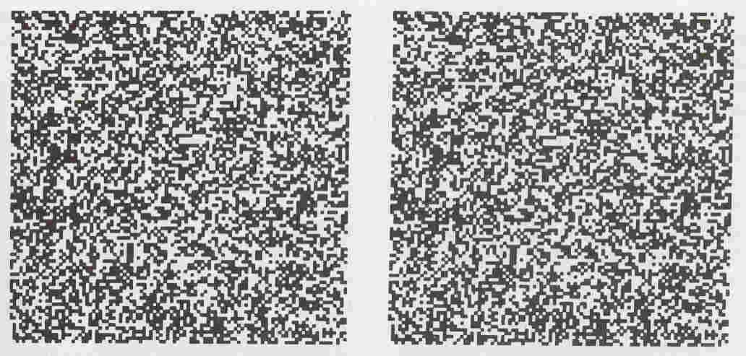
Random Dot Stereograms
Try Free Fusing This
See Hand-out

Slide 14
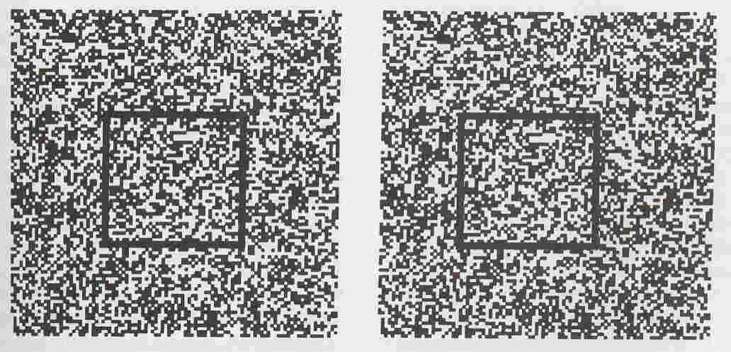
Random Dot Stereograms
Here’s the displaced region
The displacement is leftward in the right eye’s view,
which generates a crossed disparity, and appears near in depth.

Slide 15
Random Dot Stereograms
In RDSs, the central form is monocularly invisible.
Only AFTER binocular matching is the form seen.
Until the 1960’s, it was believed stereopsis required the monocularly visible forms in one eye to be matched with those in the other eye.
RDSs were a theoretical break-through, because they demonstrated that stereopsis can precede monocular form perception.

Slide 16
Random Dot Stereograms
What is the evolutionary benefit of seeing Random Dot Stereograms?
Do Random Dot Stereograms occur in nature?
Critic of Laboratory Sciences: “Those laboratory stimuli are unrealistic. Why don’t you get out of that laboratory, and study stimuli in the ‘real world’ ?”
Answer: The laboratory reveals HOW systems work by systematically isolating variables. In many naturalistic environments, variables are not easily isolated.
Without the laboratory-based discovery of Random Dot Stereograms, we’d falsely believe that form perception has to precede stereoscopic depth perception.

Slide 17
Random Dot Stereograms
Another phenomeon that would not likely be discovered under naturalistic viewing conditions is binocular rivalry….

Slide 18
Part 3
Binocular Rivalry

Slide 19
Binocular Rivalry
Bincoular Rivalry - The unstable percept that arises when the stimulus presented to one eye differs substantially from the stimulus presented to the other eye.
At any given point in space, one eye’s view is perceptually dominant (seen), while the other is perceptually suppressed (not seen).
The suppression and dominance fluctuate over time.
People often report that rivalrous stimuli are “annoying” to look at, because it is not easy to “make sense” of what is seen.
Now, let’s experience binocular rivalry…

Slide 20
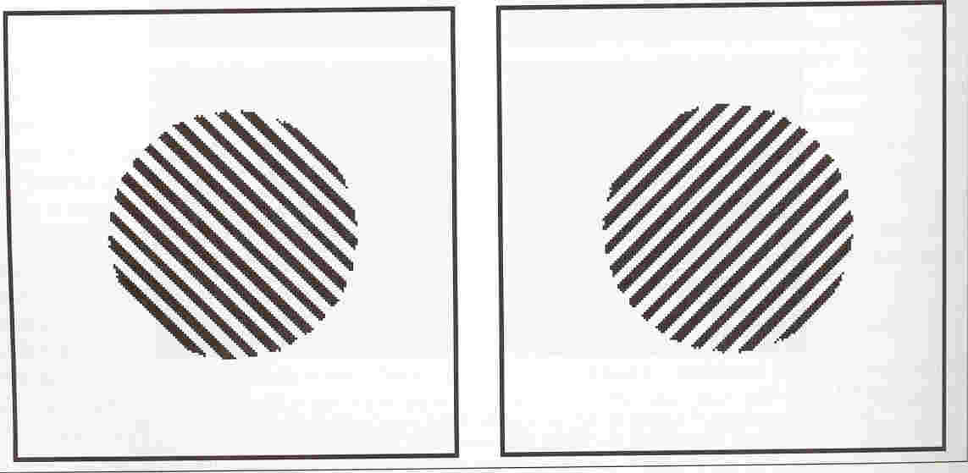
Binocular Rivalry
Try Free Fusing This
Page 4 of Hand-out
What do you see?

Slide 21
Binocular Rivalry
Now, let’s experience
binocular rivalry through
the “red-blue” filters,
so we don’t have to free fuse…

Slide 22
Binocular Rivalry Demo

Slide 23
Binocular Rivalry
Presently, researchers in the MRI lab at Stanford University are using binocular rivalry as tool for probing “consciousness” (definition?).
Consciousness - “That which goes away when we sleep.” Cristoph Koch. (I still think consciousness is a slippery topic.)
In the MRI device, subjects press one button when the horizontal image is dominant, and another button when the vertical image is dominant.
Researchers attempt to find correlations between hemo-dynamic events (blood flow) and the stimulus that the subject is “consciously experiencing”.
Let’s briefly summarize what we’ve learned about combining information from the two eyes….

Slide 24
Binocular Rivalry
When both eyes are stimulated simultaneously, one possible perceptual outcome is that the two images are fused into a unified, stable percept (e.g., stereopsis).
Alternatively, the visual system may be unable to fuse the two images. When this happens, the two views rival each other, and the percept is unstable.
Questions about binocular rivalry?

Slide 25
Part 4
Motion Parallax

Slide 26
Motion Parallax
Remember, A Monocular Depth Cue is information about about depth (i.e., relative position along the “Z” axis) that is available even in just one eye’s view.
Monocular depth cues can be moving, or stationary.
Let’s consider a moving (‘dynamic’) monocular cue …

Slide 27
Motion Parallax
Motion Parallax - a monocular depth cue based on the differences in relative motion between images of objects at different distances.
Let’s do a demo on motion parallax…

Slide 28
Motion Parallax
Close your left eye (this makes viewing ‘monocular’).
Hold your right thumb at arms length (‘all the way out’), and place your left thumb just a few inches in front of you.
Now, align both of your thumbs with a distant target, say, the “M” in ‘monocular’ on this slide.
With all three points aligned, FOCUS ON YOUR RIGHT THUMB (the more distant one), and move your head back and forth.
The distant target (‘M’) should appear to move in the direction that you move, while the near target (left thumb) should appear to move opposite you.
This difference in relative motion is motion parallax -a strong monocular cue to depth.

Slide 29
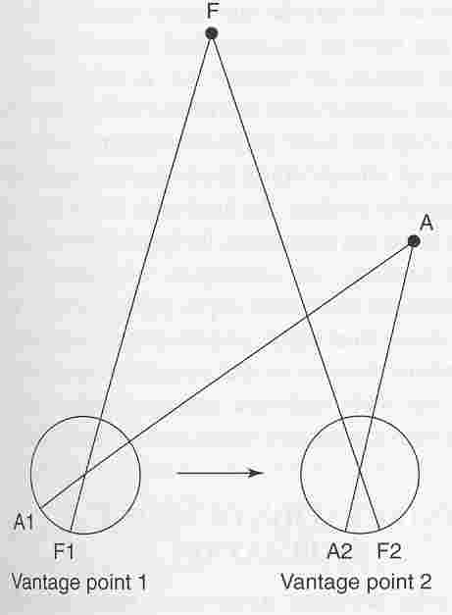
Motion Parallax Is Related to Stereopsis
The fixation point “F”, will always stimulate
corresponding retinal areas.
Point “A” will stimulate various, non-corresponding retinal areas
as you move back and forth.
If you moved 6.5 cm leftward and rightward,
you’d mimic the binocular depth cue of stereopsis!

